Slide 1
SAP ABAP - Introduction

Slide 2
ABAP
ABAP – Advanced Business Application Programming.
It is come under Technical module.
All other FI, MM, SD, PP modules are functional module.

Slide 3
ABAP
What is ABAP?
ABAP is a high-level programming language created by SAP that helps large corporations to customize the SAP ERP.
ABAP can help customize workflows for financial accounting, materials management, asset management, and all other modules of SAP.
SAP’s current development platform NetWeaver also supports both ABAP and Java.

Slide 4
ABAP
Why SAP ABAP?
.
It is a simple language that is easy to learn when it comes to programming.
It also helps SAP customers to improve their SAP-based applications.
It allows you to create custom reports and interfaces.
ABAP language is quite easy for programmers.

Slide 5
ABAP
History of SAP ABAP
ABAP is a 4/GL( Fourth generation) language developed in the 1980s.
ABAP becomes a language for developing a program for the client-server, which was first released in the year 1992.
In the year 1999, SAP introduced an object-oriented extension known as ABAP Objects

Slide 6
ABAP
In 2006, 7.0 version released which offer switch framework feature
In 2012, The version released with Table expressions feature
In 2015, with version 7.5 start supporting Open SQL expressions.
With version 7.52 in 2017, virtual sorting of the internal table feature introduced.
The latest version ABAP 7.54 was released in 2019 including features such as Static Field Control, response information, absolute type names, business service, and authorization checks

Slide 7
ABAP
R/3 – Tier Architecture
Presentation Layer
Application Layer
Database Layer

Slide 8
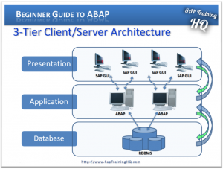
ABAP

Slide 9
ABAP
Presentation Layer
Presentation Layer is also known as client Layer
Presentation Layer is a user interaction
In SAP-User interaction purpose we use GUI
GUI stands for Graphical user interface
Example − Desktop, Mobile Devices, laptops

Slide 10
ABAP
Application Layer
Application Layer is also known as Kernel Layer and Basic Layer.
SAP application programs are executed in Application Layer.
Application Layer serves as a purpose of a communicator between Presentation and Database Layer.
Application server is where the dispatcher distributes the workload to the different work processes makes the job done.

Slide 11
ABAP
Database Servers
Database servers contain specialized systems with fast and large hard-drives.
Database layer stores the data
Data store can be Business data, SAP system data, SAP tables, Programs.
Examples − Oracle, Microsoft SQL Server, IBM DB/2, Siebel, Sybase, etc.

Slide 12
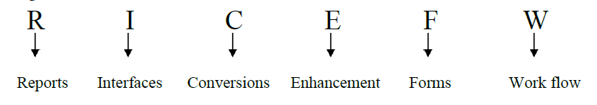
ABAP
Role of an ABAP’er in real time:-

Slide 13
ABAP
Report: -
Based on the given input we’ll fetch [read or get] data from data base and display in a predefined format.
Types of Reports:-
1. Classical Reports
2. Interactive Reports
3. ALV Reports

Slide 14
ABAP
Classical Reports: - It’s nothing but to display the entire information in a single list.
Interactive Reports: - It’s nothing but to display the summarized information in the basic list and detailed information in further lists.
ALV Reports: - This is used to display the data with additional features.
i.e. Borders, colors, sorting, shades, lines etc.

Slide 15
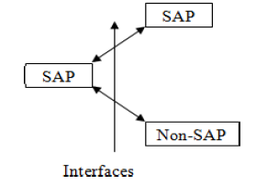
ABAP
Interfaces: -
Interfaces are used to connecting from SAP to SAP as well as SAP to non-SAP. Interfaces are ALE/IDOCS, BAPI

Slide 16
ABAP
Conversion: -
Conversion programs are used to transverse the data from file to SAP system.
Conversion programs are BDC,LSMW
Enhancements: -
Enhancements are used to adding some additional functionality to the standard functionality with out disturbing the standard functionality.
Enhancements are BADI, user exists, customer exits, enhancement frame work, enhancement spot

Slide 17
ABAP
Forms: -
Forms are used to design the business documents such as offer letters, experience letters, pay bills etc.
Forms are SAP Script, SMART forms.
Work flow: -
Work flow is used to automate the exist business process & used to identify the work load of employee as well as performance of the employee.

Slide 18
ABAP
SAP LANDSCAPE
1) Development Server
2) Quality Server
3) Production Server

Slide 19
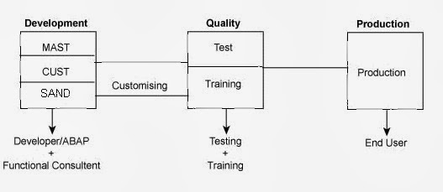
ABAP

Slide 20
ABAP
Source Code:
The source code of an ABAP consists of either a statement or comment.
A statement is the collection of operators, operands, variables and keywords.

Slide 21
ABAP
Operators:
In ABAP we’ve 3 types of operators
1) Mathematical Operator
2) Comparative Operator
3) Relational or Logical Operator

Slide 22
ABAP
Mathematical Operator:-
Operator Description Example
+ Addition 3 + 2 = 5
- Subtraction 3 – 2 = 1
* Multiplication 3 * 2 = 6
** Exponentiel 3 * * 3 = 32 = 9
/ Division 4 / 2 = 2
Mod Reminder of division 5 mod 2 = 1
Of two numbers

Slide 23
ABAP
Comparative Operator:-
Operator Description Example
< or LT Less than a < b or a LT b
<= or LE Less than or equal a <= b or a LE b
> or GT Greater than a > b or a GT b
>= or GE Greater than or equal a >= b or a GE b
= or EQ Equal a = b or a EQ b
<> or NE Not equal a <> b or a NE b

Slide 24
ABAP
Relational or Logical Operator:-
Operator Description Example
And AND a < b and a < c
Or OR a < b or a < c

Slide 25
ABAP
ABAP Standard Data Types
ABAP standard data types (built-in data types) are divided into two groups:
Complete
Incomplete

Slide 26
ABAP
Complete ABAP Standard Data Types
The built-in ABAP standard data types that already contain a type-specific, fixed-length specification are considered complete data types.

Slide 27
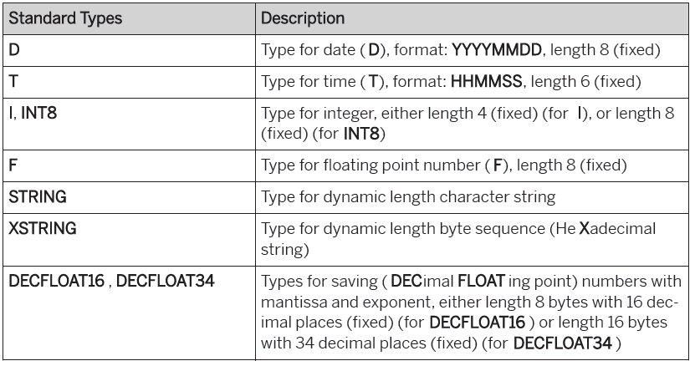
ABAP

Slide 28
ABAP
Incomplete ABAP Standard Data Types
The standard types that do not contain a fixed length are considered incomplete data types.
When they are used to define data objects, you need to specify the length of the variable.

Slide 29
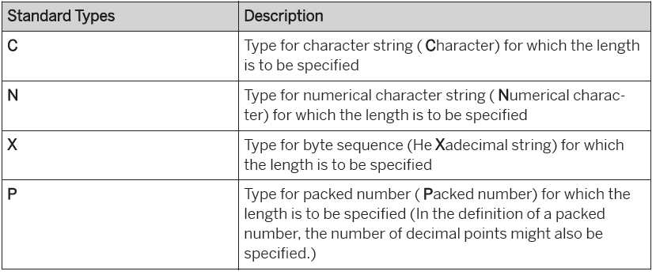
ABAP

Slide 30
SAP ABAP DBMS & RDMS

Slide 31
ABAP
What is ABAP Dictionary?
ABAP dictionary is one of the best tool of ABAP workbench and it is a central repository for data definitions in SAP system. It is mainly used to store the data definitions, create and maintain user defined types.
The most important features are:
• Integrated to an ABAP/4 Development Workbench.
• Active in the runtime environment.
Data dictionary used for :
Management of data definitions.
Development of ABAP program.
Design and maintain database objects.

Slide 32
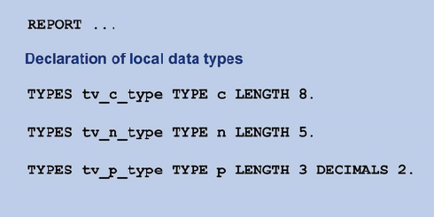
Local Data Types
In an ABAP program, you can use the TYPE addition to refer directly to a structure. If you define a local data type in a program by referring to a structure as follows: TYPES dtype TYPE structure. the construction blueprint of the structure is used to create a local structure dtype in the program.

Slide 33
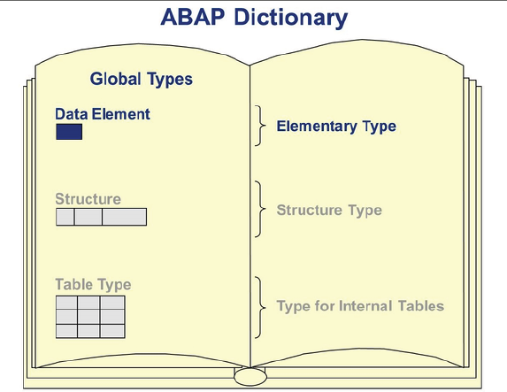
Global Data Types
A data type defined in the ABAP Dictionary is called global, as it can be used throughout the entire SAP system concerned

Slide 34
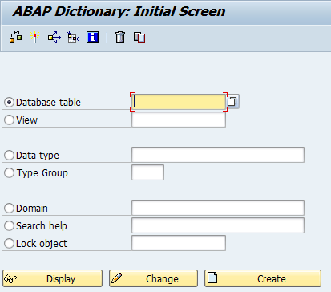
T.Code for ABAP Dictionary is SE11.

Slide 35
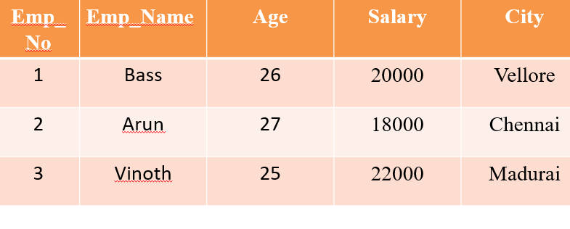
What is Table :-
A Table is a Collection of data elements organized in terms of Rows and Columns.

Slide 36
2.What is Record :-
A Single Entry in a Table is called Record or Row or Tuples.
A Record in a Table Represents set of Related Data.
EX :-

Slide 37
What is Field :-
A Table Consists of several Records(Rows), Each Records can be brocken into Several Smaller Entities known as Fields.
EX :-
Emp_id, Emp_Name, Age, Salary, City.

Slide 38
DBMS
A DBMS is Special Software that Allows Creations, Definitions, Manipulation of Database.
DBMS is actually a tool used to perform any kind of operations on data in Database..
Some popular Database are….
MySql, ORACLE, MS Access, IBM DB2…..

Slide 39
RDBMS
RDBMS is a Database Mangement System based on Relational Model Introduced by E.F Codd.
RDBMS is used to manage Relational Database,
Relational database is a collection of organized set of tables from which data can be accessed easily.
Relational database is Most Commonly used Database, its consists of number of Tables and each Tables as its own Primary Key.

Slide 40
SQL Constraints
SQL constraints are used to specify rules for the data in a table.
If there is any violation between the constraint and the data action, the action is aborted by the constraint.
Constraints can be specified when the table is created (inside the CREATE TABLE statement) or after the table is created (inside the ALTER TABLE statement).
Constraints could be column level or table level. Column level constraints are applied only to one column, whereas table level constraints are applied to the whole table.

Slide 41
1.SQL NOT NULL Constraint :-
The NOT NULL constraint enforces a column to NOT accept NULL values.
The NOT NULL constraint enforces a field to always contain a value.
Example:-
Create TABLE Student ( Roll_no int NOT NULL,
First_Name Char(50) NOT NULL,
Midd_Name Char(20),
Last_name char(30) NOT NULL,
Age int)

Slide 42
2.SQL UNIQUE Constraint
The UNIQUE constraint uniquely identifies each record in a database table.
The UNIQUE and PRIMARY KEY constraints both provide a guarantee for uniqueness for a column or set of columns.
Example :-
Create TABLE STUDENT ( Roll_No int UNIQUE,
Name char(50),
Age int,
Lib_no int UNIQUE).

Slide 43
3.SQL PRIMARY KEY Constraint
The PRIMARY KEY constraint uniquely identifies each record in a database table.
Primary keys must contain UNIQUE values.
A primary key column cannot contain NULL values.
Most tables should have a primary key, and each table can have only ONE primary key.
Example :-
Create TABLE STUDENT ( Roll_No int PRIMARY KEY,
Name char(50),
Age int,
Address char(50))

Slide 44
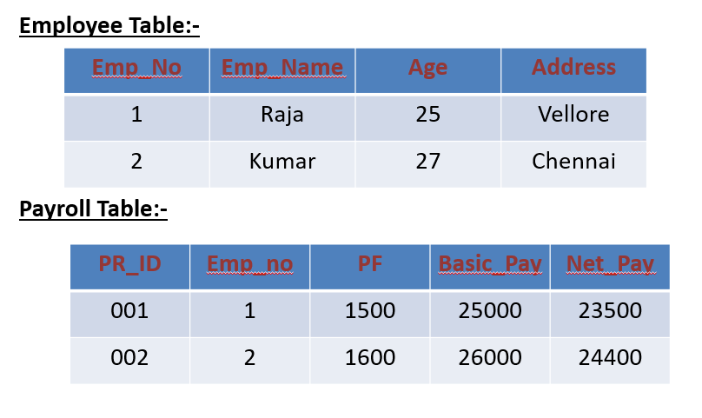
4.SQL FOREIGN KEY Constraint
A FOREIGN KEY in one table points to a PRIMARY KEY in another table.

Slide 45
Example Queries:-
Employee Table:-
Create TABLE Employee (Emp_id int PRIMARY KEY,
Emp_Name Char(50),
Age int,
Address char(40))
Payroll Table :-
Create TABLE Payroll ( PR_ID int PRIMARY KEY,
Emp_id int FOREIGN KEY REFERENCES Employee (Emp_id),
PF int,
basic_Pay int,
Net_pay int)

Slide 46
5.SQL CHECK Constraint
The CHECK constraint is used to limit the value range that can be placed in a column.
If you define a CHECK constraint on a single column it allows only certain values for this column.
Create TABLE Student ( Roll_ No int CHECK ( Roll_No >0),
Name char(20),
Age int)
If you define a CHECK constraint on a table it can limit the values in certain columns based on values in other columns in the row.
Create TABLE Student ( Roll_ No int ,
Name char(20),
Dept char(10),
CONSTRAINT chk CHECK(Roll_No>0 AND Dept =‘CSE’))

Slide 47
6.SQL DEFAULT Constraint
The DEFAULT constraint is used to insert a default value into a column.
The default value will be added to all new records, if no other value is specified.
Example:-
Create TABLE Student (Roll_no INT ,
Name CHAR(20),
Dept CHAR(10) DEFAULT ‘CSE’)
7.SQL CREATE INDEX Statement
The CREATE INDEX statement is used to create indexes in tables.
Indexes allow the database application to find data fast; without reading the whole table.
Create INDEX IDX1 ON STUDENT(Emp_No)

Slide 48
What is Normalization?
Normalization is the process of efficiently organizing data in a database.
There are two goals of the normalization process:
i) Eliminating redundant data (for example, storing the same data in more than one table)
ii) Ensuring data dependencies make sense
(only storing related data in a table)

Slide 49
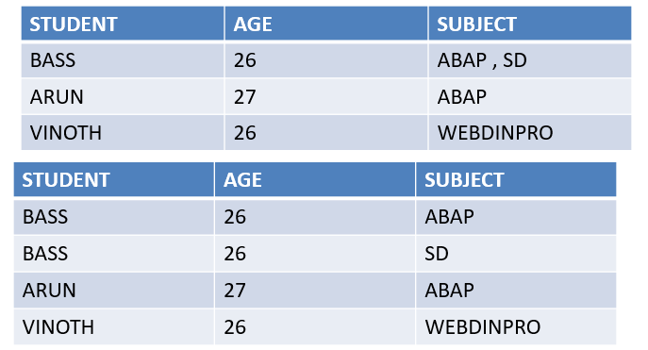
1. First Normal Form (1NF)
First normal form (1NF) sets the very basic rules for an organized database.( Row wise elimination)
i) Eliminate duplicative columns from the same table.
ii) Create separate tables for each group of related data and identify each row with a unique column or set of columns (the primary key).

Slide 50
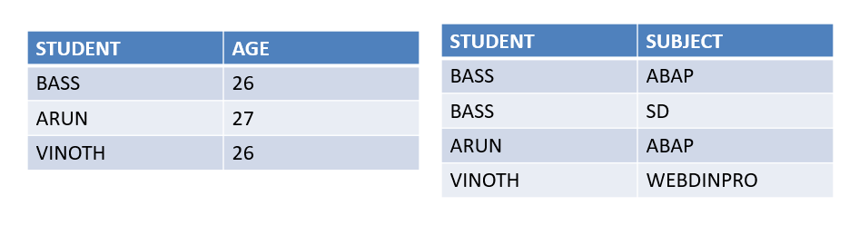
Second Normal Form (2NF)
Second normal form (2NF) further addresses the concept of removing duplicative data: (Column level Elimination)
Meet all the requirements of the first normal form.
Remove subsets of data that apply to multiple rows of a table and place them in separate tables.
Create relationships between these new tables and their predecessors through the use of foreign keys.

Slide 51
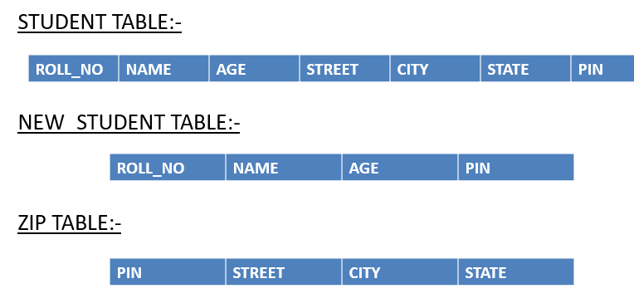
Third Normal Form (3NF)
Third normal form (3NF) goes one large step further:
I)Meet all the requirements of the second normal form.
II)Remove columns that are not dependent upon the primary
key.

Slide 52
Boyce-Codd Normal Form (BCNF or 3.5NF)
The Boyce-Codd Normal Form, also referred to as the "third and half (3.5) normal form", adds one more requirement:
I) Meet all the requirements of the third normal form.
II) Every determinant must be a candidate key.
A 3NF Table which does not have multiple overlapping candidate keys is said to be in BCNF.

Slide 53
SAP ABAP Data Dictionary (DDIC)

Slide 54
ABAP Data Dictionary (DDIC)
ABAP Data Dictionary, also known as DDIC, is a central repository in the SAP system where all the metadata related to the database objects are stored.
The elements that make up a DDIC are known as metadata. Metadata is the computing term for the data whose function is to describe other data.
An advantage of having a DDIC is avoiding inconsistencies when defining data types that will later be used in different parts of an application; this avoids redundancies and considerably decreases the cost of maintenance.
When a type of data is defined in DDIC, it is available to any program or function module in the application. A change in the definition of a type of data in the DDIC automatically affects any other data, module, function, or program which has data or variables defined using the modified data type.

Slide 55
ABAP Data Dictionary (DDIC)
The ABAP Data Dictionary provides a graphical user interface (SE11) for developers to create, change, and maintain the database objects and also provides a set of APIs for programmatic access to the metadata stored in the DDIC, and SE16 for Data Browser.
This allows for efficient and centralized management of the data structures and definitions in an SAP system.
The DDIC also plays an important role in ensuring data consistency and integrity by enforcing referential integrity constraints and by providing support for data types and data domains.
Additionally, the ABAP Data Dictionary provides tools for generating database-independent ABAP code, which helps to simplify database migrations and improve the portability of SAP applications.

Slide 56
ABAP Data Dictionary (DDIC) - Tasks
Object Definition: The DDIC provides a central repository for the definition of database objects, such as tables, views, structures, and data elements. This includes the definition of the data types, lengths, and other properties of these objects.
Data Integrity: The DDIC enforces referential integrity constraints and data validation rules to ensure the consistency and accuracy of the data stored in the database.
Code Generation: The DDIC provides tools for generating database-independent ABAP code, which helps to simplify database migrations and improve the portability of SAP applications.
Security: The DDIC provides mechanisms for controlling access to database objects and for protecting sensitive data from unauthorized access.

Slide 57
ABAP Data Dictionary (DDIC) - Tasks
Performance Optimization: The DDIC provides features for optimizing the performance of database objects, such as indexing and caching, which help to improve the performance of database operations in SAP.
Data Access: The DDIC provides a centralized and consistent way to access and manage data in the database, which simplifies the process of developing and maintaining SAP applications.
User Interface: The DDIC provides a graphical user interface (SE11) for managing and maintaining the definitions of database objects in the DDIC. This interface provides a convenient and user-friendly way to create, change, and maintain database objects in SAP.

Slide 58
ABAP Data Dictionary Levels
The ABAP Data Dictionary has three levels:
Domain level: The domain level defines the data type and attributes of individual fields. This includes the type of data (such as numeric, alphanumeric, or date/time), the size of the field, and any constraints or validation rules that apply.
Data element level: The data element level provides a higher level of abstraction over domains. Data elements combine one or more domains to define a specific semantic meaning for a field, such as “material number”, “customer name”, or “sales order date”.
Table level: The table level is the highest level of abstraction in the ABAP Data Dictionary. Tables define the structure and relationships between data elements and domains, allowing for the creation of complex data models that can be used to store and retrieve data in the SAP system.

Slide 59
Data Dictionary Objects
Database Tables
Views
Data Types
Type Groups
Domain
Search Helps
Lock Objects

Slide 60
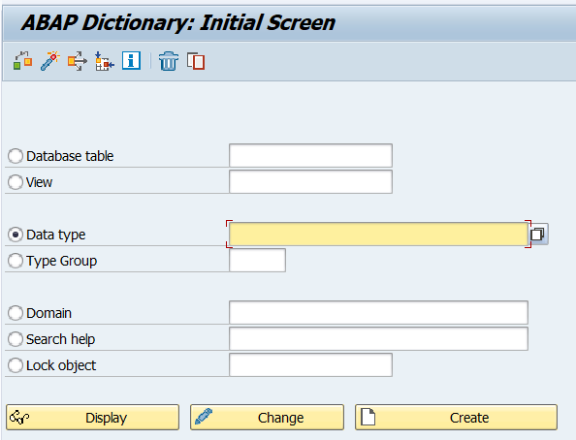

Slide 61
Database Tables
In SAP ABAP, database tables are used to store data in the SAP system. The data is stored in rows and columns, similar to a spreadsheet. Tables can be defined in the ABAP Data Dictionary (DDIC) using the SE11 transaction. The DDIC provides a set of tools to define tables and their fields, including field properties, keys, and indexes.
There are Three Types of Tables in SAP ABAP
Transparent Tables
Pooled Tables
Cluster Tables

Slide 62
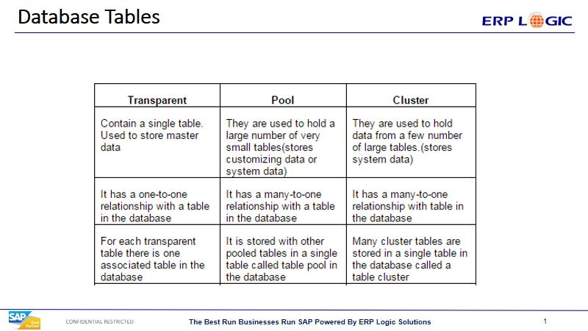
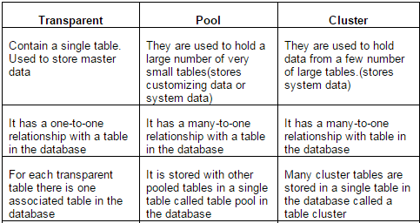
Database Tables

Slide 63
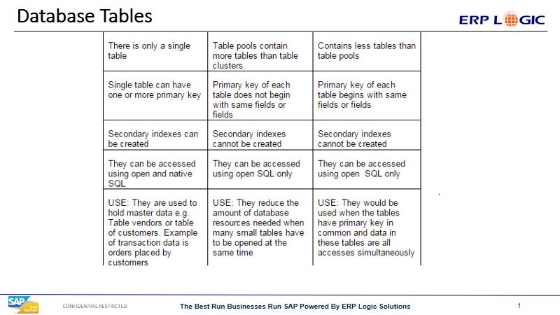
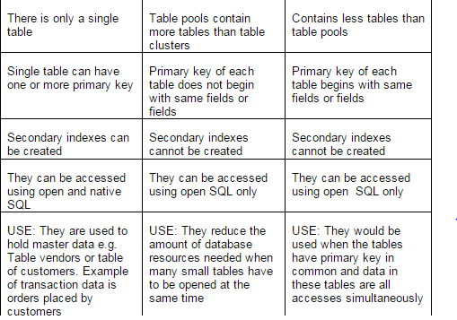
Database Tables

Slide 64
Database Tables
Creating Tables: Tables can be created in the ABAP Data Dictionary (DDIC) using the SE11 transaction. The DDIC provides a set of tools for defining the fields, keys, and indexes of the table. The structure of a table can be changed using the ALTER statement, but this should be done with caution, as changes to the table structure can affect existing programs that use the table.
Storing Data: Data is stored in tables in rows and columns, similar to a spreadsheet. Data can be added to tables using the INSERT statement and can be retrieved from tables using the SELECT statement. Tables can also be joined with other tables to retrieve data from multiple sources.

Slide 65
Database Tables
Pooled and cluster tables are generally used only by SAP and not used by developers
Secondary Indexes cannot be created on Pooled and Cluster Tables.
Pooled and cluster tables Cannot be read from outside SAP
Transparent & Pooled table can be buffered
Cluster table cannot be buffered.

Slide 66
Database Tables
Check table
It is defined at field level.
For foreign key relation , we must enter the check table name.
Value table
It is maintained at Domain level.
For foreign key relation - If we maintained value table, foreign key relation automatically generated.

Slide 67
Views
View is a logical representation of summarized data from one or more tables
Views are logical databases. It doesn’t contain the data permanently. At run time only view contains the data.
If the database view created on single table, then the insertion can be done using view also. If same created on multiple tables, then the view is a read only view.

Slide 68
View Types
There are 4 types of Views,
1) Database views
2) Projection views
3) Maintenance views
4) Help views

Slide 69
Database View
A database view is defined in the ABAP Dictionary and automatically created in the database during activation.
Database view created on two (or) more tables by clubbing the fields using INNER JOIN.
We can only read the data (Not able to write)
Since, database view uses INNER JOIN – it selects only the matching records.
Can include an entire table.

Slide 70
Projection View
A view that is created on single table.
Main advantage is to project only required or important fields by removing the unwanted fields.
We can read and maintain the data, since the view is created on single table.
System performance : Projection view is faster than database view.

Slide 71
Maintanance View
Maintenance view implements an outer join.
All the tables included in this view must be linked with foreign keys.
We can do read and maintain the date.
Mostly we create this view for ZTABLE rather than for SAP Standard tables.

Slide 72
Help View
A help view is a special view for use in search helps.
Help view implements an outer join.
For this view, we can only read the data, can’t maintain the data.
We can’t execute HELP view directly, because they are designed specially for “Search-Helps”
Note : Data base view & help views are used in selection method of elementary search.

Slide 73
Views
Creating Views: Views can be created in the ABAP DDIC using the SE11 transaction. The DDIC provides a set of tools for defining the fields, keys, and indexes of the view. The structure of a view can be changed using the ALTER statement, but this should be done with caution, as changes to the view structure can affect existing programs that use the view.
Using Views: Views can be used to simplify data access by providing a consolidated view of the underlying data. Data can be retrieved from views using the SELECT statement, just like with tables. Views can also be joined with other views or tables to retrieve data from multiple sources.

Slide 74
Search Help
Search help in SAP ABAP is a tool that helps the user find a specific value within a data field. It is a type of input help that is used to display a list of valid values for a field. Search helps can be assigned to fields in the DDIC to provide the user with a list of valid values during data entry. Search helps can be defined in the ABAP DDIC using the SE11 transaction.
There are two types of search helps.
1. Elementary search help
2. Collective search help

Slide 75
Elementary Search Help
Specifies a single search help
The elementary search help must define where data should read from.
It is created from a single table

Slide 76
Collective Search Help
Collection of more than one search help
It offers several alternative search paths

Slide 77
Search Help
Creating Search Help: Search help can be created in the ABAP DDIC using the SE11 transaction. The DDIC provides a set of tools for defining the fields, data sources, and search logic for the search help.
Using Search Help: Search help is used in transactions to provide a list of possible values for a specific field. The search help can be used to simplify data entry and ensure that only allowed values are entered for a specific field.

Slide 78
Lock Objects
Lock objects in SAP ABAP are used to synchronize access to shared data. Lock objects are used to prevent concurrent access to the same data by multiple programs, which can cause data inconsistencies and errors.
When ever we create & activate the lock object it generates two function modules
Enqueue (Locking)
Dequeue (Unlock)
The lock object name must be start with EZ or EY.

Slide 79
Lock Objects
Creating Lock Objects: Lock objects can be created in the ABAP DDIC using the SE11 transaction. The DDIC provides a set of tools for defining the lock object and the data that it protects.
Using Lock Objects: Lock objects are used in programs to synchronize access to shared data. The lock object is used to prevent concurrent access to the same data by multiple programs, ensuring that data inconsistencies and errors are prevented.

Slide 80
Type Groups
Type groups in SAP ABAP are used to group data types together for easier management and reuse. The data types within a type group can be used in multiple programs, making it easier to maintain consistency in data definitions.
Type group is allow to define date types directly in ABAP Dictionary, Instead of defining them in an ABAP Program.
The name of a type group in ABAP DDIC must have a max. length of Five characters.
These defined data types can be used in an ABAP program with the help of the TYPE-POOLS Statement.

Slide 81
Type Groups Syntax
REPORT ZTEST
TYPE-POOLS ZTYPE
DATA: NAME type ZTYPE_NAME,
AGE type ZTYPE_AGE.

Slide 82
Data Type
A data type in SAP ABAP is a definition of the type of data that can be stored in a field. The DDIC provides a set of predefined data types, such as character, numeric, and date, as well as the ability to define custom data types. Data types are used to define the fields in tables and structures.
Predefined Data Types: The ABAP DDIC provides a set of predefined data types, such as character, numeric, and date. These data types can be used to define the fields in tables and structures.
Custom Data Types: The ABAP DDIC also provides the ability to define custom data types. Custom data types can be used to define data that has unique characteristics not covered by the predefined data types.
Using Data Types: Data types are used to define the fields in tables and structures. The data type of a field determines the type of data that can be stored in the field, as well as the size and format of the data.

Slide 83
Data Type
Structure Data Type
It is a Data type used to define a structured data object like Work area.
DATA: WA1 TYPE <STRUCTURE>. "this will create a Work area
Table Data Type
It is a Data type used to define an Internal data object. It will store all the attributes to define an internal table, such as Table type, Key fields etc.
DATA: it1 TYPE <table type>. "this will create an Internal table

Slide 84
Domain
A domain in SAP ABAP is a data type definition in the DDIC that is used to define a specific field in a table. It provides a set of rules that governs the values that can be entered into the field, such as the data type, length, and number of decimal places. Domains can be defined in the ABAP DDIC using the SE11 transaction.
Purpose of Domains: A domain in SAP ABAP is a data type definition in the DDIC that is used to define a specific field in a table. A domain defines the data type and rules for a specific field, such as the size, format, and allowed values of the data.
Creating Domains: Domains can be created in the ABAP DDIC using the SE11 transaction. The DDIC provides a set of tools for defining the data type, size, and format of the domain, as well as any additional rules or restrictions for the data.
Using Domains: Domains are used to define the data type and rules for specific fields in tables. By using domains, data definitions can be standardized and reused across multiple tables, making it easier to maintain consistency in data definitions.

Slide 85
SAP ABAP Tables and Joins

Slide 86
What is Internal Table: INTERNAL TABLE are used to obtain data from a fixed structure for dynamic use in ABAP. Each line in the internal table has the same field structure. The main use for internal tables is for storing and formatting data from a database table within a program. What is Work area: Work areas are single rows of data. They should have the same format as any of the internal tables. It is used to process the data in an internal table one line at a time

Slide 87
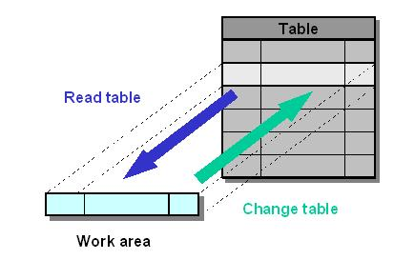
Difference between Internal Table and Work area:

Slide 88
Types of Internal tables: There are three types of Internal tables. They are →Standard →Sorted →Hashed Standard and sorted tables are known as Indexed tables

Slide 89
Standard Internal Table: →This is the most appropriate type if you are going to address the individual table entries using the index. →It accepts the duplicate records. →Here all fields are non-unique. →Passing data from work area to internal table is always through Append keyword. →Searching of a record is linear search Syntax - Data <Internal Table> like standard table of <work area>.

Slide 90
Sorted Internal table →This is the most appropriate type if you need a table which is sorted as you fill it. →It may or mayn’t accept the duplicate. →Here, we must specify at least one filed as unique \ non-unique. →Pushing data from work area to internal table is always through Insert keyword. →Searching of a record is Binary search Syntax - Data <Internal Table> like sorted table of <work area> with unique / non-unique key <field> ----

Slide 91
Hashed table: →This is the most appropriate type for any table where the main operation is key access. →It won’t accept the duplicate records →Here we must specify at least one filed as unique →Pushing data from work area to internal table is always through Collect keyword. →Searching of a record is by using Hash algorithm. Syntax - Data <internal table> like Hashed table of <work area> with unique <field1> <field2> --.

Slide 92
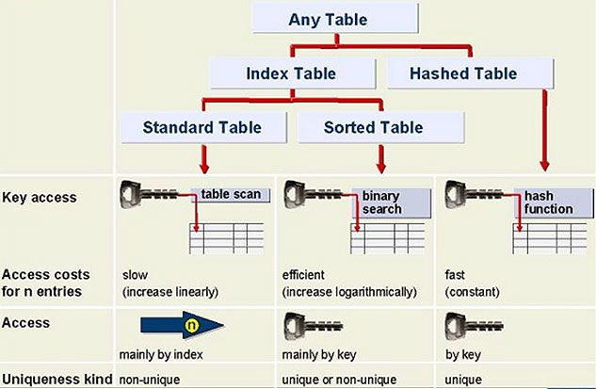
Hierarchy of Internal tables:
In the real time most of the times we use standard internal table because we are working with data of data base table. In the data base there is no duplicate data. Sometimes we use Hashed internal tables. By default, internal table is standard internal table.

Slide 93
Joins: Joins are used to fetch the data from more than one table. It Joins the columns of two or more data sources in a results set in a join expression Types of Joins: →Inner Join. →Left Outer Join. →Right Outer Join. →Full Outer Join. →Referential Join. →Text Join.

Slide 94
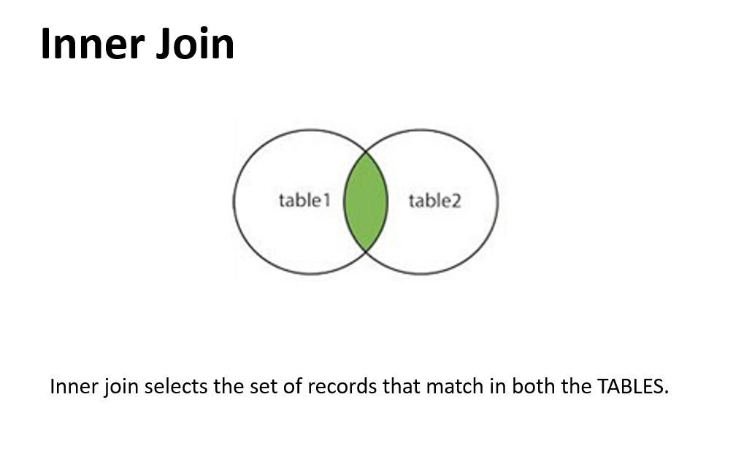

Slide 95
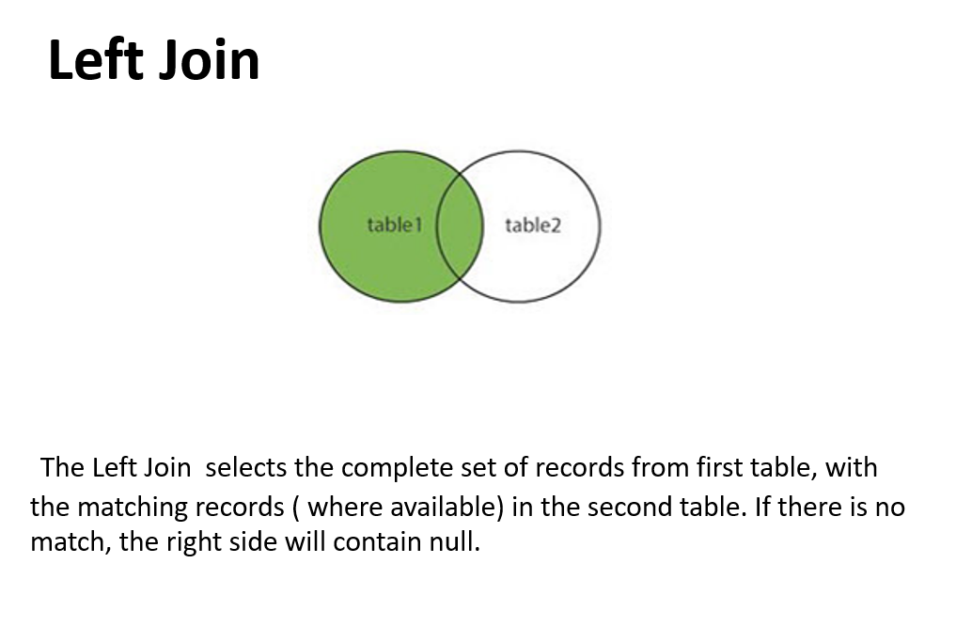

Slide 96
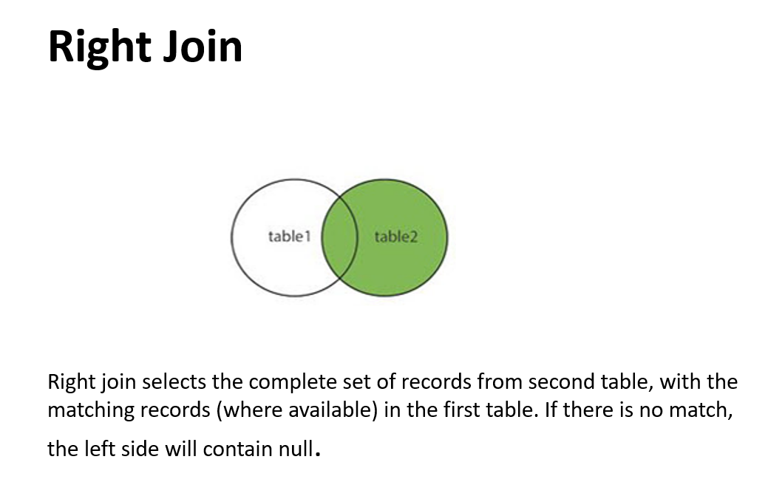

Slide 97
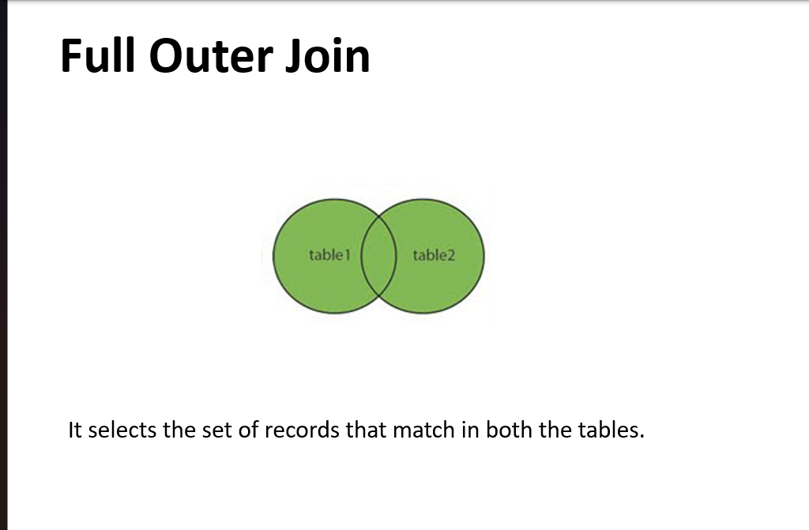

Slide 98
SAP ABAP Events

Slide 99
ABAP
EVENTS
It is used to trigger some actions.
Events are ABAP processing blocks that are called by the
runtime system in a particular order and processed sequentially.

Slide 100
ABAP
Characteristics of Event Blocks
Introduced with an event keyword
Ends by beginning the next processing block
Cannot be nested
Existence is not absolutely necessary
Sequence of event blocks is unimportant
Implicit standard event block in executable program: START-OF-SELECTION

Slide 101
ABAP
ORDER OF EVENTS
Load of Program
Initialization
At selection-screen
At selection-screen output
Start of Selection
End of Selection
Top of Page
Top-of-page During Line-Selection.
End of Page
End of Selection
At User-Command
At Line-Selection.
At PF status

Slide 102
ABAP
Classical reports Events
We can see output in single list.
1.Initialization 2.Start-Of-Selection. 3.Top-of-page. 4.End-of-page. 5.End-of-selection.

Slide 103
ABAP
LOAD-OF-PROGRAM .
This event is to load the program into memory for execution. This is internal event, which we cannot see.
The event LOAD-OF-PROGRAM should mainly be used to initialize global data when calling external procedures or transactions.
The LOAD-OF-PROGRAM event should not be used in executable programs

Slide 104
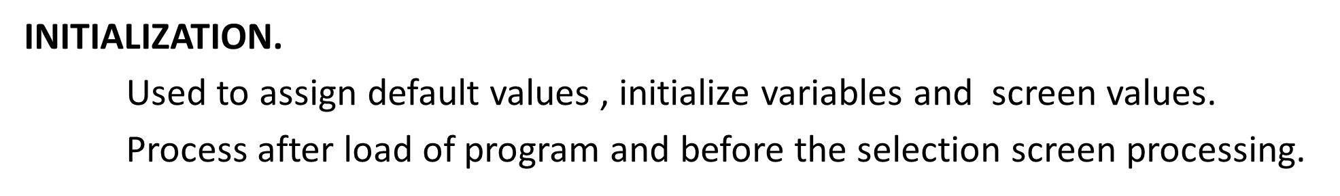
ABAP
INITILIZATION event can be used for :
To initialize the input fields of the standard selection screen
Change the default values of parameters
E.g.
LAND1 = ‘IN’
SPRAS = ‘EN’
WERKS = ‘US

Slide 105
ABAP
AT SELECTION SCREEN
This event is used to validate multiple fields of the selection screen
Whereas AT Selection-screen on field is used to validate a single input field
AT SELECTION-SCREEN OUTPUT
This event is to modify the selection screen dynamically based on user actions on the selection screen.
This event is triggered (or) executed for every action on the selection screen.

Slide 106
ABAP
Start of selection
It is the default event in any program.
This is where the actual business logic or body of the program starts.
It is also used to indicate the starting point of a program.
Top of Page
This event is used to display constant page heading for all the pages in the output screen.
This event is triggered after the first WRITE statement.

Slide 107
ABAP
End of page
This event is used to provide constant footer information across the all pages of the list screen.
To display end of page (or) footer information we have to reserve some lines as footer lines using the statement,
Report <Report name> Line count Total Lines ( Footer Lines)
E.g. REPORT ZSEN LINE COUNT 30(3)

Slide 108
ABAP
End of selection
It is used to indicate the start of selection has been ended. It is mainly used with logical database, which are obsolete in ABAP.
This is the last of the events called by the runtime environment to occur
END OF PAGE IS a footer for each list display. Whereas END OF SELECTION IS the final page of a Report.

Slide 109
ABAP
Interactive Reports Events
Displaying the basic information on the basic list and the detailed information in the secondary list is called as interactive reports.
In SAP, there are 21 list, out of which first list is called as basic list with list number 0 and remaining lists are called as secondary lists.
At Line-selection
At User Command
At PF Status
Top of Page During line selection

Slide 110
ABAP
At Line-selection
This event will trigger whenever the user double click on any list line
At User Command
This event will trigger whenever user clicks on any custom buttons of the GUI.

Slide 111
ABAP
At PF Status
This event will trigger whenever user clicks on any function buttons.
Top of Page During line selection
This is used to print heading for secondary lists in interactive reports

Slide 112
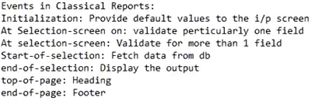
ABAP
Simply in One sentence

